Slide 1

Self Presentation
.NET DISCIPLINE
Victor Avtandilyan

Slide 2
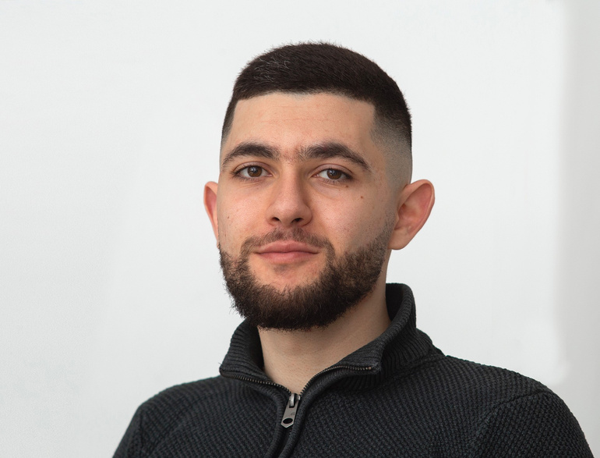
About me
Software Engineer with 5+ years of experience, 5+ years in .NET
My core skills:
.NET technologies such as ASP.NET Core, Entity Framework
Relational and Non-Relational databases
Authentication, Authorization, Role base access control, HMAC, OAuth2
Cloud platforms (mostly Azure)
Documenting, writing
My focus areas
My focus areas:
Web API development, Desktop apps, Database management
Project management and ownership
Learning, teaching and sharing experience in understandable way
Victor

Slide 3
Working experience/career path overview
Started the career with Database first monolith desktop project with custom ORM and business logic handled in SQL SPs and Functions then moved to microservices Web APIs with EF as the ORM.
(Make this more visible during migration) Simultaneously started and managed my pet project to help my fitness trainer to work with his trainees online seamlessly and promptly where I involved my friends and created tasks for them on GitHub Project with diagrams and detailed descriptions.
2019
Mersoft – CRM, Warehouses, hotels, clinics (Developer)
Title: Software engineer
2022
EPAM – Swiss Re – re-insurance company
(Developer)
Title: Software engineer
2023
EPAM - S&P Global (Key Developer)
2021
VOLO – shipment management cargo
(Developer)
Title: Software engineer
2023
EPAM – Philip Morris – Tobacco domain
(developer)
Title: Software engineer
2024
EPAM - LSEG – (Senior Developer)
Title: Software engineer

Slide 4
SECTION 1
DEVELOPMENT EXPERIENCE AND KNOWLEDGE
CONFIDENTIAL | © 2024 EPAM Systems, Inc.
4

Slide 5

DEV EXPERIENCE: EPAM Swiss Re — page 1/2
OVERVIEW
Business
Key facts
Domain – Reinsurance company
Period of involvement: <STARTDATE> - <ENDDATE>
Team of 9 people
Main stack: .NET, PostgreSQL
Infrastructure: Azure, Microservices, Docker
High level Technical architecture
Tech stack
.NET
Postgresql
Azure
Microservices powered by dapper sidecar, deployed on Azure
CONFIDENTIAL | © 2024 EPAM Systems, Inc.
5

Slide 6
DEV EXPERIENCE: EPAM Swiss Re — page 2/2
MY PARTICIPATION
MY ROLES
My key achievements
Integrate Azure Cognitive Search as a separate microservice
Implement new features, refactor complex, unmaintainable code and fix bugs
Refactored custom dynamic questionnaire using PredicateBuilder and hiding all the logic in methods so the main method would be easily readable thanks to verbose methods signature for better readability and maintainability.
Created services for Azure Search with methods such as repository with CRUD operations that supports convenient querying, service that utilizes Azure Search SDK for documents indexation, re-indexation, creation and deletion.
Highlights
Integrated Azure Search to transfer and store data from PostgreSQL to optimize read operations.
Challenging parts: It wasn’t straight forward because by the time I was implementing there was lacking support from Azure’s library for .NET (NuGet). So, I had to dig the documentation and find right endpoints to make a HTTP request, check the response and wrap it into convenient service class methods.
CONFIDENTIAL | © 2024 EPAM Systems, Inc.
5

Slide 7

DEV EXPERIENCE: EPAM Philip Morris — page 1/2
OVERVIEW
Business
Key facts
Domain – tobacco production
Period of involvement: <STARTDATE> - <ENDDATE>
Team of 4 people (back, front, dev ops, product owner)
Tobacco producer
Main stack: .NET Web API, MSSQL, Docker, AWS
High level Technical architecture
Tech stack
.NET
Postgresql
AWS
Web API with clean architecture
CONFIDENTIAL | © 2024 EPAM Systems, Inc.
5

Slide 8
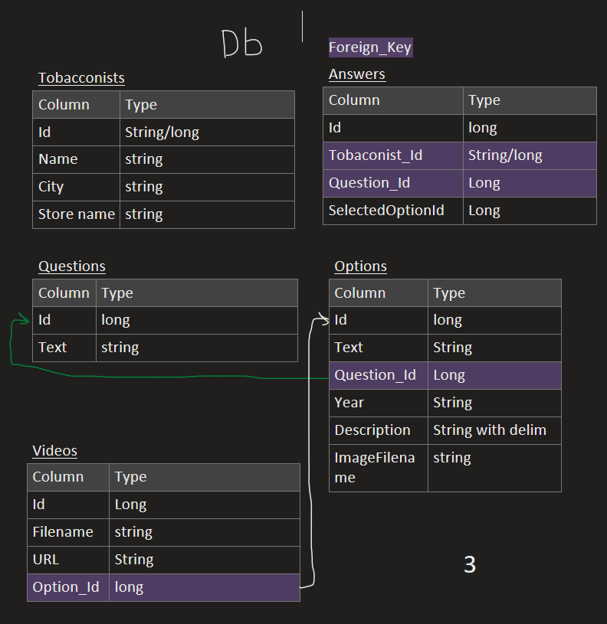
DEV EXPERIENCE: EPAM Philip Morris — page 2/2
MY PARTICIPATION
MY ROLES
DB schema draft example
Developed from scratch a backend service which serves client’s feedback questionary that had to be displayed in tobacco stores in France.
MY KEY ACHIEVEMENTS
Quickly delivered a scalable, maintainable Web API with growth potential by implementing clean architecture principals.
Questions and answers were stored in database which made it dynamic and easy to alter.
Change questionnaire content without front or back-end application deployment.
Future proof for more features such as reports and more.
The data could be used ported and used in data warehouses for analyzing the answers and generate aggregated feedbacks.
CONFIDENTIAL | © 2024 EPAM Systems, Inc.
5

Slide 9

DEV EXPERIENCE: EPAM S&P Global — page 1/2
OVERVIEW
Business
Key facts
Stocks market
Stand alone code pieces that syncs data in database when another dependent data is changes. Involves complex business logic and sometimes recursion and functional programming mostly for hierarchical structures.
Period of involvement: <STARTDATE> - <ENDDATE>
Team of 8 people
Stocks
Custom transactional and eventual consistency services
High level Technical architecture
Tech stack
.NET,
MSSQL,
Kafka,
xUnit, BDD
Huge project with different parts that interact with each other via message brokers (mainly Kafka), I can’t call it microservices.
CONFIDENTIAL | © 2024 EPAM Systems, Inc.
5

Slide 10
DEV EXPERIENCE: EPAM S&P Global — page 2/2
MY PARTICIPATION
MY ROLES
MY KEY ACHIEVEMENTS
As a key developer in a newly formed team I was accumulating information from both technical and business people and sharing it with my team
Helped my peers to debug and understand big, complex SQL queries.
Understand legacy code from last decades and bring it to new standards.
This project was mostly about communication and acquiring knowledge, best practices from more experienced teams
Got rid of recursive and chatty db calls by making a single query to db and getting all necessary info and then manipulate with data in recursive manner. Understood 20 years old code with Boolean flags that change behavior of the code and even scope that involves. It was tough. Covered it with unit tests.
Optimized derivation logic that was taking 23 seconds to 1.3 seconds (17 times faster), got rid of nested and heavy loops, made use of HashSets for quicker lookups, etc..
Escalated cases that UAT team didn’t notice before.
OTHER
Dramatically improved time and space complexity.
Made life of future engineer easier with better code and well documented logic in Markdown format with examples and ready to test queries.
CONFIDENTIAL | © 2024 EPAM Systems, Inc.
5

Slide 11
DEV EXPERIENCE: EPAM LSEG — page 1/2
OVERVIEW
Business
Key facts
Stocks market
Period of involvement: June 2024 - Present
Team of 5 people
<Business domain>
<Technology stack>
<Other important information>
High level Technical architecture
e.g. <“Monolith with 10 products, micro-services high load, etc.”>
<“Any technically important details that helps to understand complexity of the project”>
<“Future growth from technical perspective”>
<“Add diagrams in architecture section”>
CONFIDENTIAL | © 2024 EPAM Systems, Inc.
5

Slide 12
DEV EXPERIENCE: EPAM LSEG — page 2/2
MY PARTICIPATION
MY ROLES
My key achievements
STILL ONBOARDING PROCESS
<Lengthy, detailed explanation of your roles and responsibilities>
<Lengthy explanation of decisions you made>
<Other lengthy explanations>
OTHER
<Most interesting/challenging technical work you’ve done>
<Any other facts that cover requirements for the position, e.g.
L3: https://kb.epam.com/display/EPMASMT/.NET+Discipline%3A+Requirements+for+L3+position
L4: https://kb.epam.com/display/EPMASMT/.NET+Discipline%3A+Requirements+for+L4+position >
<etc.>
CONFIDENTIAL | © 2024 EPAM Systems, Inc.
5

Slide 13
DESIGN AND DOCUMENTATION SKILLS
CONFIDENTIAL | © 2024 EPAM Systems, Inc.
13

Slide 14




Highlights
.NET docs contribution
Projects
Threads: Scheduling threads
Managing pet project
Answers
.NET hacks
Technical articles
SQL: implicit UNKNOWNs
DIAGRAMS

Slide 15
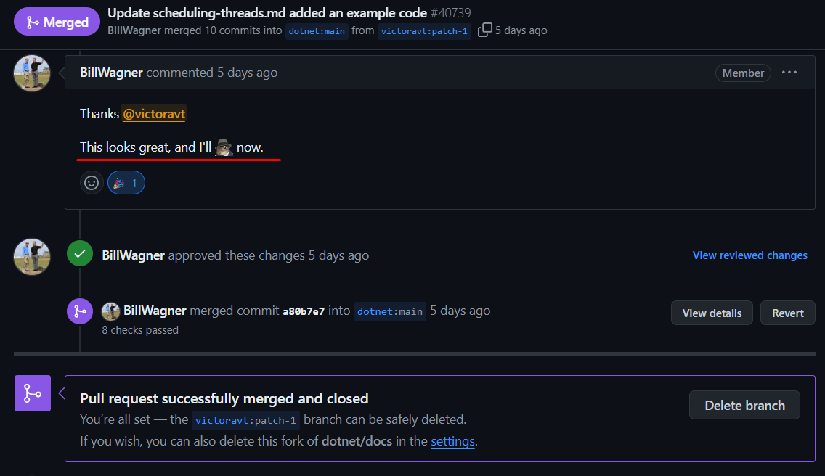
.NET docs
contribution
Threading: Scheduling threads
Included new code snippet with
description

Slide 16
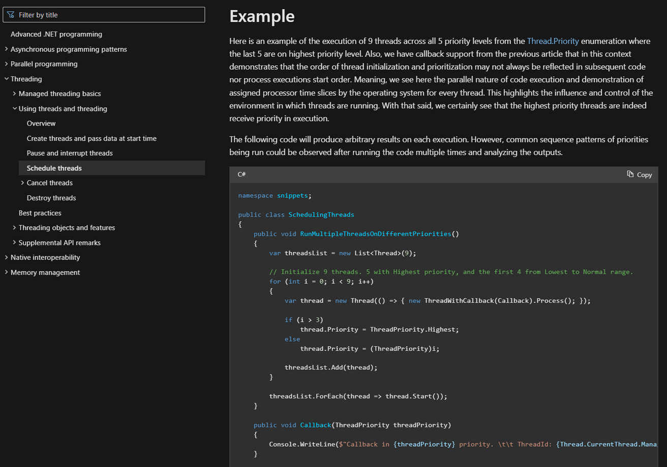
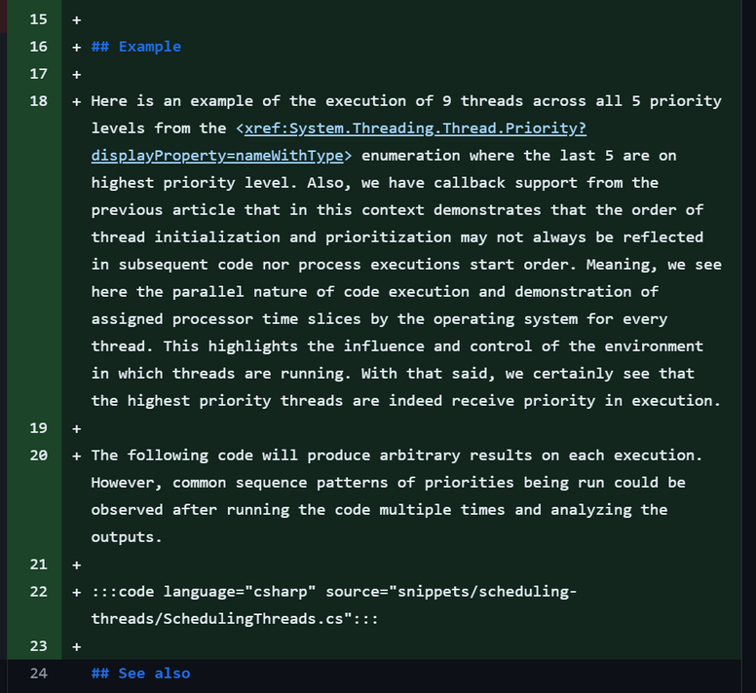
.NET docs
contribution
Threading: Scheduling threads
Prepares readers for the code example by reminding and referencing to the previous articles.

Slide 17
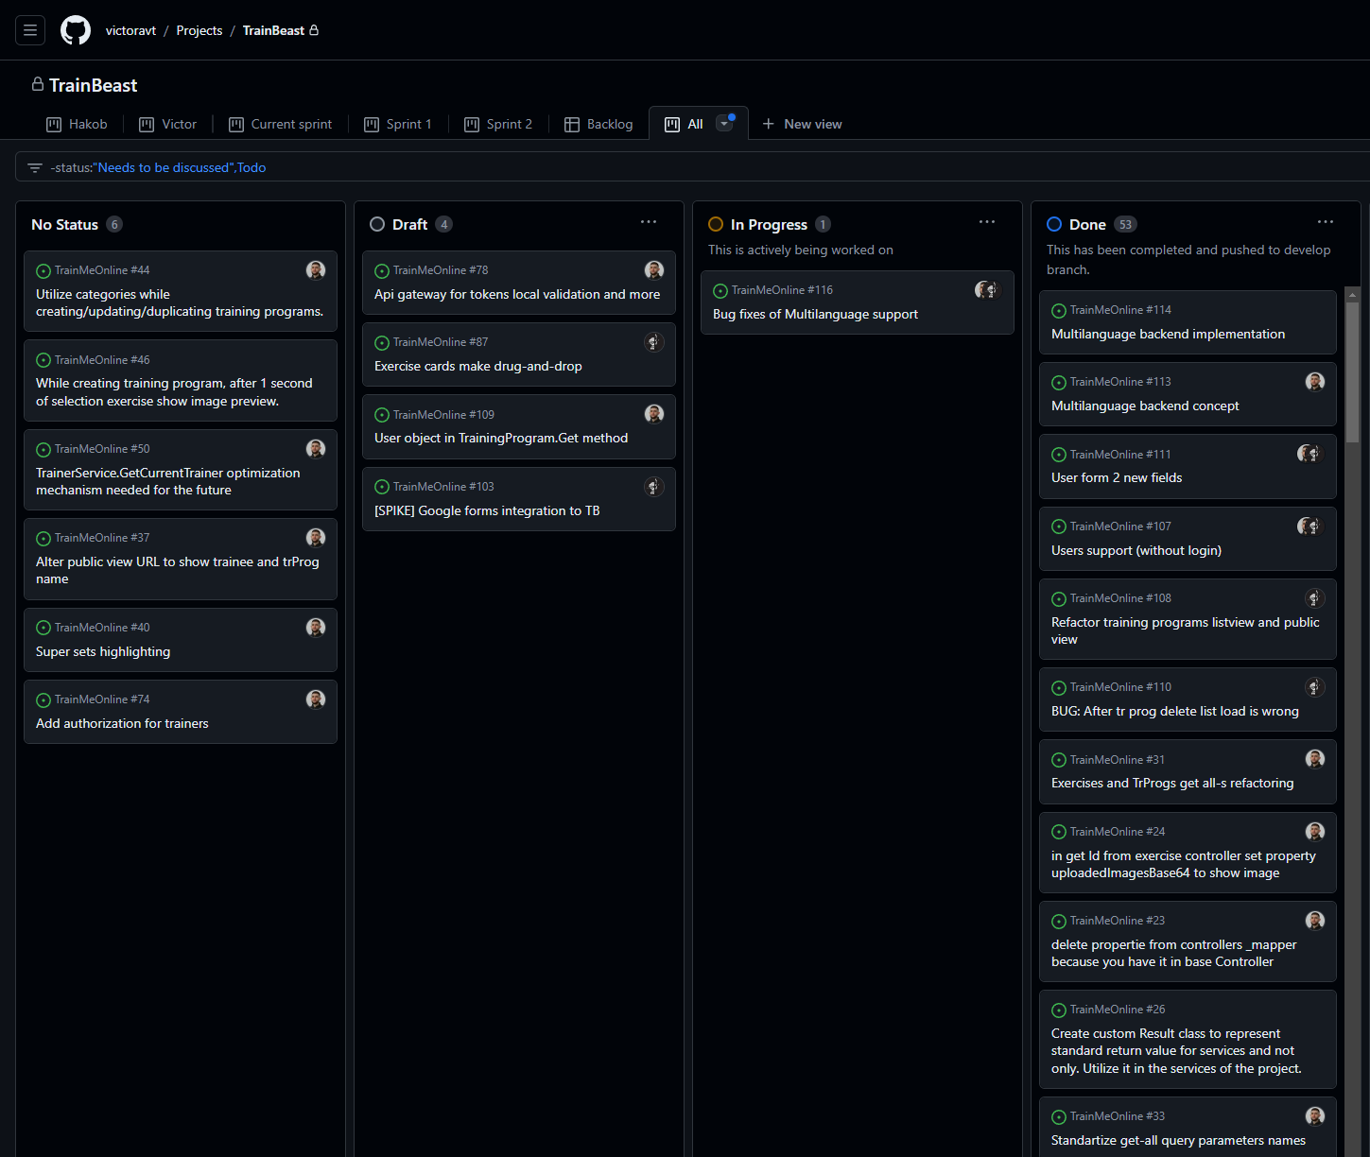
Project
Domain: Fitness application
Intermediate between trainee and trainer

Slide 18
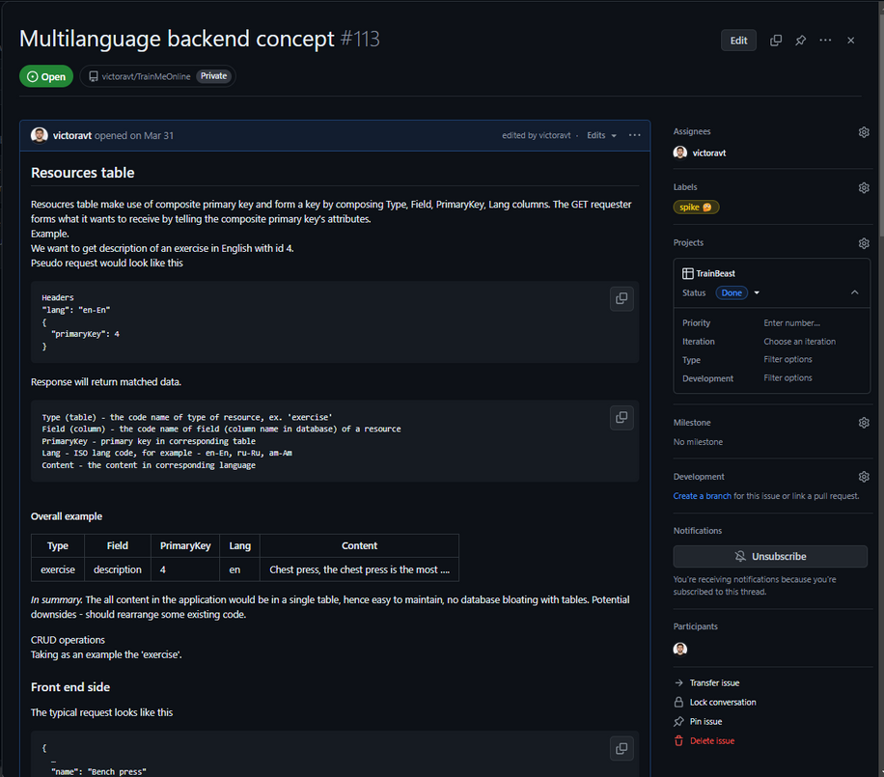
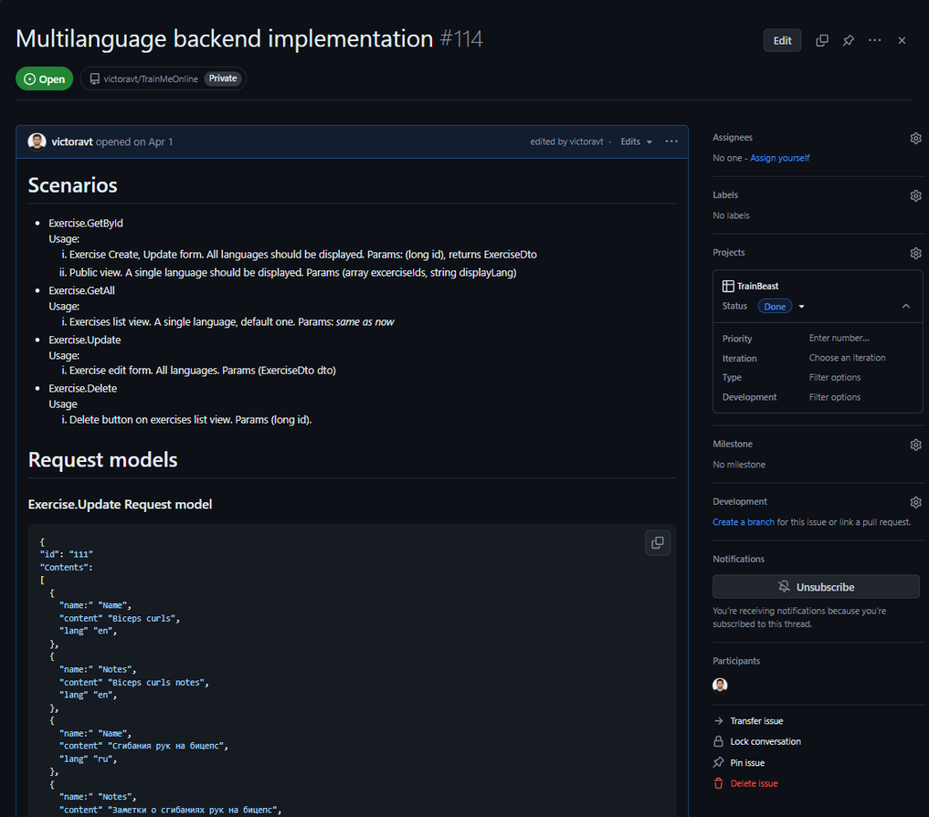
Ticket examples
Adding localization on ongoing project
Project
Domain: Fitness application
Intermediate between trainee and trainer

Slide 19
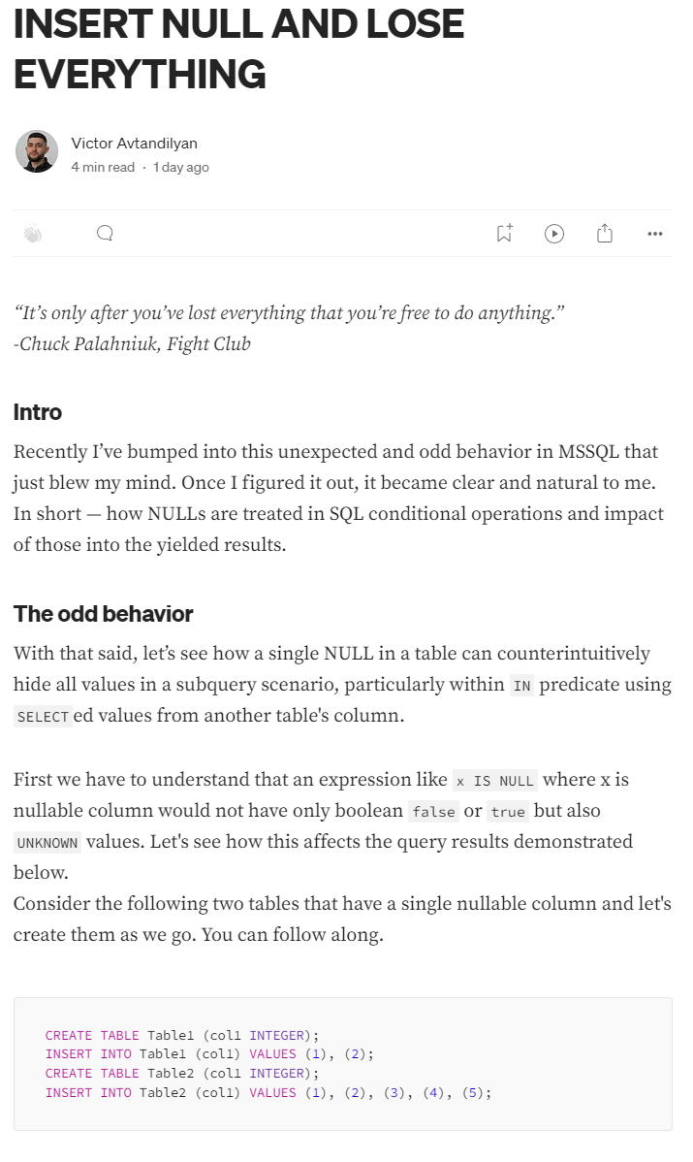
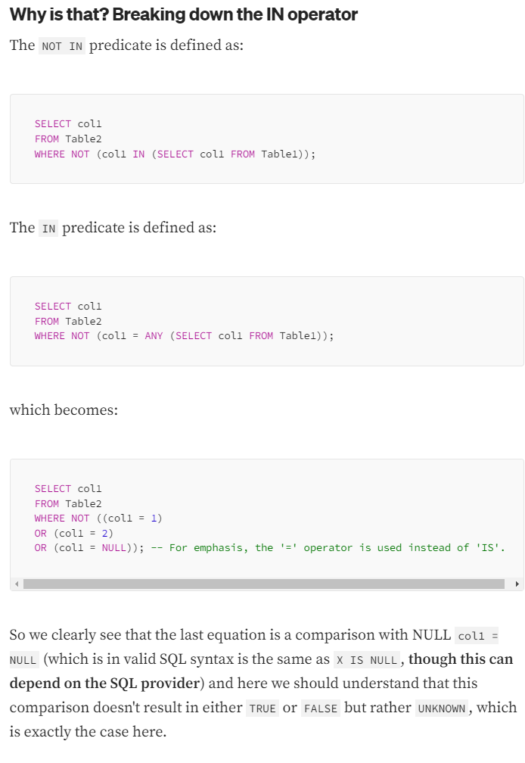
Articles
Latest’s topic: UNKNOWNs in SQL
Title: Insert NULL and lose everything
Described comparison with NULL and what it hides.
Link

Slide 20
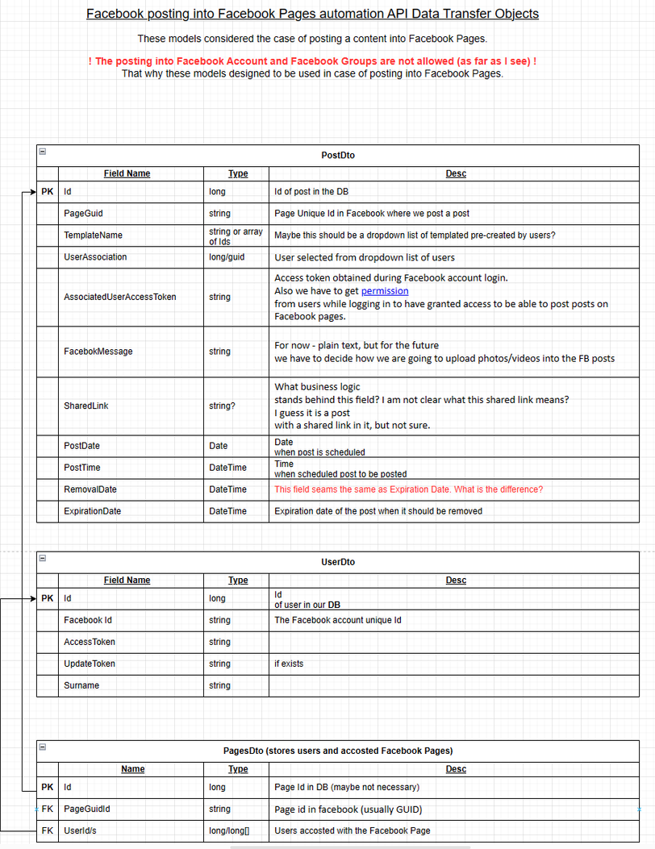
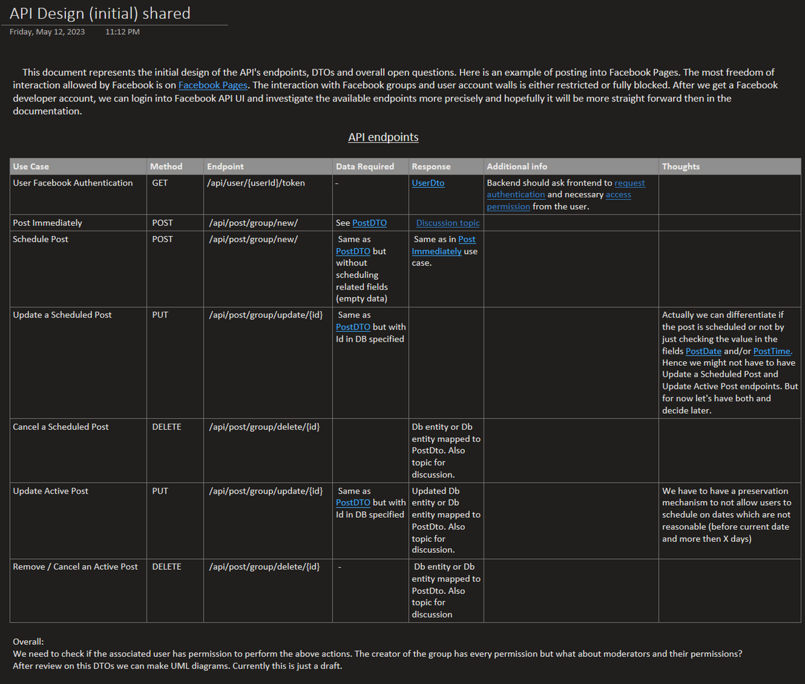
API integration
FaceBook Pages API integration research and design for automated content poster service

Slide 21
Quality
CONFIDENTIAL | © 2024 EPAM Systems, Inc.
22

Slide 22
(Still RAW)QUALITY: Overview and My participation
Able to explain what code quality is and how to measure it. Knows code metrics
Has experience in creating efficient unit/component/integration tests
Follows software engineering best practices and principles, and can explain their benefits (e.g. SOLID, GRASP, DRY, KISS)
Works according to EPAM ENGX practices
Following SOLID principals
Covering with unit test vital business parts.
Code Review
<What you did, how did you contribute>
<ENGX experience: set up unit tests, testing pyramid, engineering best practices, etc.>
<Any quality process from development point of view: static code analysis, CI/CD pipelines, code reviews, etc.>
<Any other facts that cover requirements for the position, e.g.
L3: https://kb.epam.com/display/EPMASMT/.NET+Discipline%3A+Requirements+for+L3+position
L4: https://kb.epam.com/display/EPMASMT/.NET+Discipline%3A+Requirements+for+L4+position >
<etc.>
CONFIDENTIAL | © 2024 EPAM Systems, Inc.
23

Slide 23
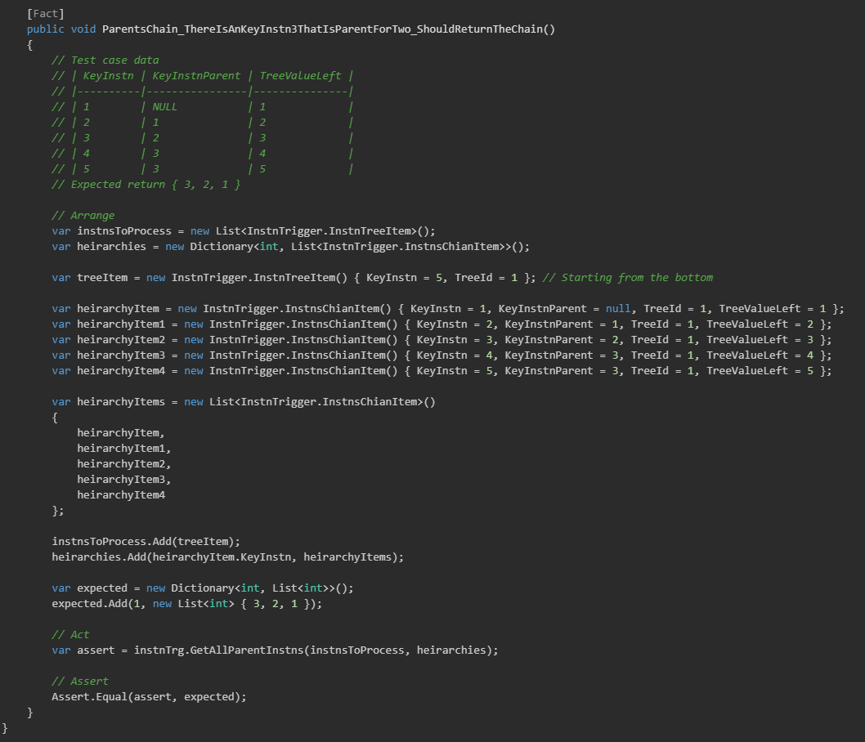
QUALITY: Unit testing
Unit test example
CONFIDENTIAL | © 2024 EPAM Systems, Inc.
24

Slide 24
SOFTWARE PROCESS KNOWLEDGE
CONFIDENTIAL | © 2024 EPAM Systems, Inc.
25

Slide 25
SOFTWARE PROCESS: Overview <e.g. the team and you, and any diagram>
Example manager/ customer
Solution architect group
QA group
3ʳᵈ party vendor developers
Product managers
I’m here
SA 1
Lead QA
Developer
Important manager
DM 1
QA
CONFIDENTIAL | © 2024 EPAM Systems, Inc.
26

Slide 26
SOFTWARE PROCESS: My participation
In enterprises
Participated in sprint plannings, retrospectives, story point evaluation, daily standups. Made changes into work items content if was necessary.
In pet project
As it was demonstrated, made work items, performed code review, managed other developer’s work and scope of required changes.
CONFIDENTIAL | © 2024 EPAM Systems, Inc.
27

Slide 27
FINAL WORDS
CONFIDENTIAL | © 2024 EPAM Systems, Inc.
28

Slide 28
SUMMARY. Why I’m ready for the next position
ROLES PLAYED ON A PROJECT – My last position on Epam project was a Key Developer and in the current is senior. Also, I played role of Project coordinator and architect’s role on my side non-profitable fitness application project.
DEVELOPMENT EXPERIENCE AND KNOWLEDGE – My main goal in knowledge transfer is to explain thing that I wish it had been explained to me by setting topic’s boundaries, locating key aspects so the lister can connect the dots, understand scope of the topic and “draw” a map in mind and then filling the space with details but not going outside of the scopes by that avoiding unrelated/unnecessary thoughts and questions. (Maybe, mention about some published article, posts)
DESIGN, ARCHITECTURE AND DOCUMENTATION SKILLS – I can explain given solution’s pros and cons in terms of time, effort, justified effort, expendability and maintainability. My vision is – go as simple as possible unless it is necessary to make code comply certain patterns and architectural principals. We should deliver working product that is agile and easy to change, instead of going fast initially and then struggle with early architectural designs which hard to foresee if it is justified.
RELIABILITY – I can work without supervision and able to predict potential issues and ask clarifying questions ahead. Also, I’m able to answer aroused questions by myself by looking at the code, commit history, etc. Codding is the latest thing to do.
CONFIDENTIAL | © 2024 EPAM Systems, Inc.
29

Slide 29
Ready to answer your questions
Thank you!
CONFIDENTIAL | © 2024 EPAM Systems, Inc.
30

